Slide 1


Wavecon Telecom 5G Impact Analysis
Impact on Revenue, Plans, and Key Metrics
by Khiroda Kumar Gouda

Slide 2
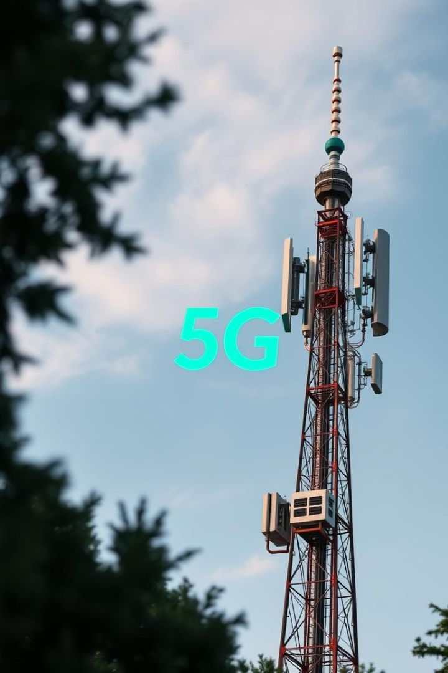
Wavecon Telecom Analysis
5G Impact
Revenue, Plans, Key Metrics
Prepared By
Khiroda Kumar Gouda
Date
15/06/2025

Slide 3

Executive Summary
Revenue Dip
Post-5G revenue fell 0.5%.
KPI Stagnation
ARPU and MA flat.
High Churn
Customer churn persists.
Mixed Plans
Some plans thrive, others fail.

Slide 4
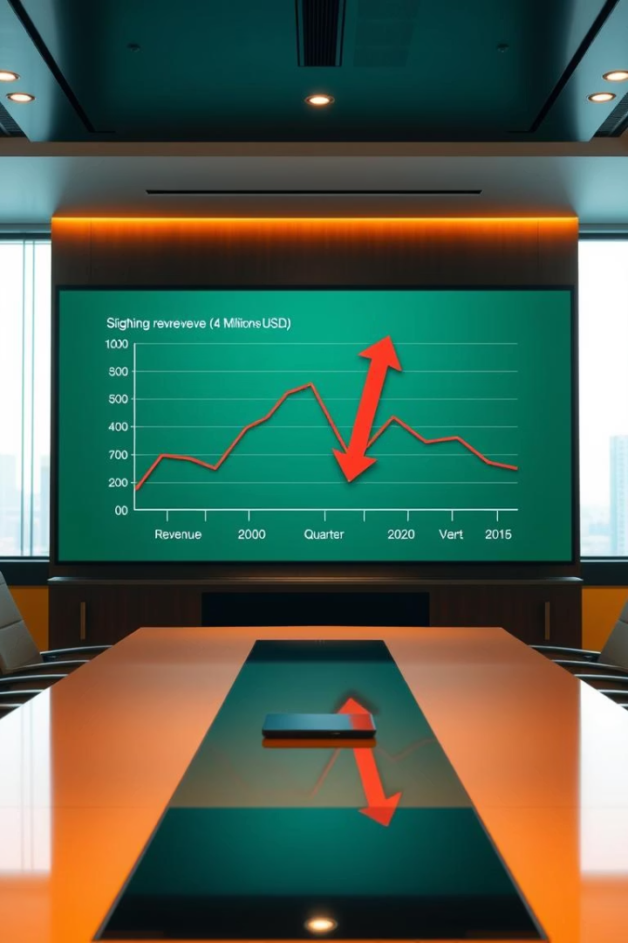
Impact of 5G Launch on Revenue
16.0bn
15.9bn
-0.50%
Before 5G
After 5G
Change
Revenue in ₹
Revenue in ₹
Revenue decrease
Temporary rise in June–July, then fall by September. 5G didn’t boost revenue.

Slide 5
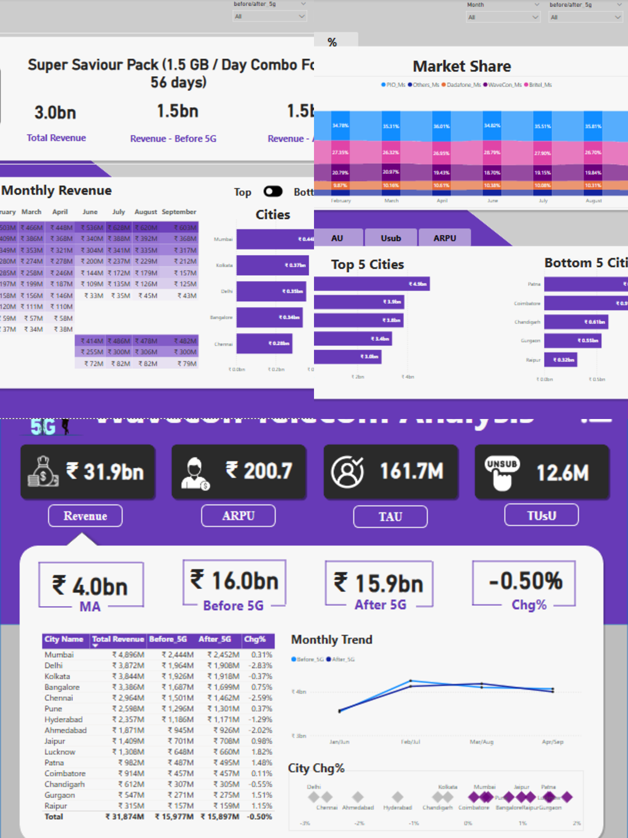
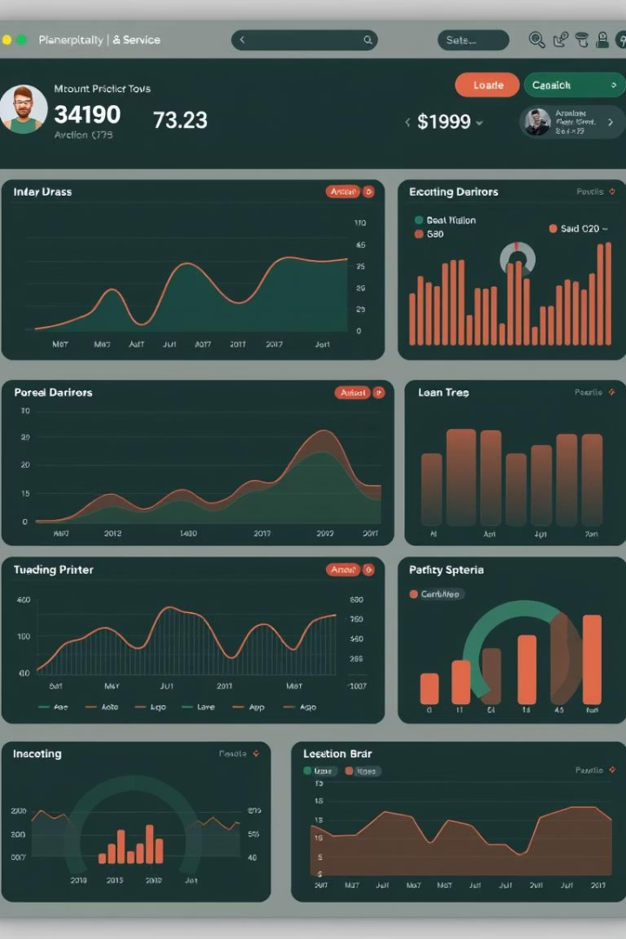



Underperforming KPIs Post-5G
Monthly Average
Flat at ₹4.0bn
ARPU
₹200.7, unchanged
Unsubscribed
12.6M users
Churn and stagnation show limited 5G monetization success.

Slide 6
Best Performing Plans Post-5G
p2 (Super Saviour Pack)
p12
₹1.5bn before and after.
Strong growth in Aug–Sep.
Focus on retaining and bundling these plans.

Slide 7




Worst Performing Plans Post-5G
p6
Constant low revenue.
p7
Constant low revenue.
p13
Constant low revenue.
Audit customer feedback; consider rebranding or removing.

Slide 8



Plan Affected Largely by 5G
Plan p13
1
Revenue collapsed after 5G.
Recommendation
2
Likely no longer viable.
Action
3
Consider discontinuation.

Slide 9
Discontinued or Fading Plans
No Official Discontinuation
1
No formal announcement.
p13 and p6
2
Low-to-no revenue.
Silently Phased Out
3
Possibly removed quietly.
Insight: User disinterest or overlap with better options.

Slide 10
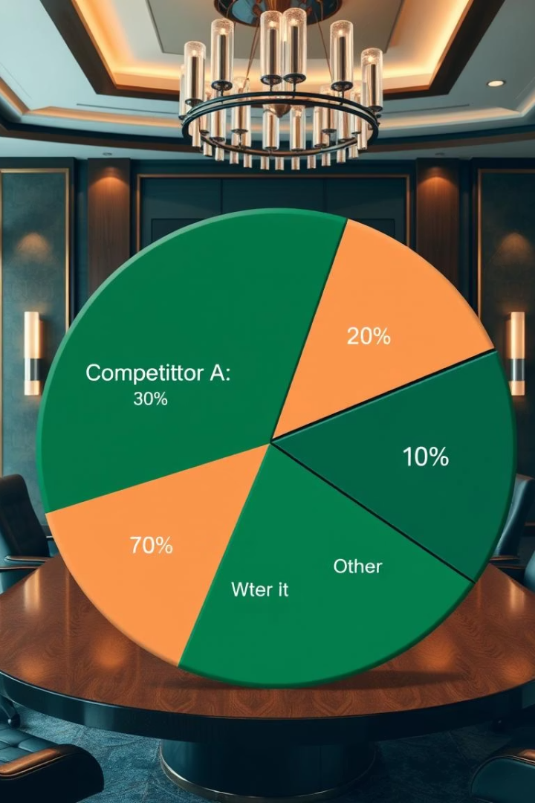
Market Share Trend
Wavecon
Stable share
PIOL
Slightly gaining
Datacone
Slightly gaining
Action: Reconsider competitive pricing, improve data bundles.

